Slide 1


Geologic Time
Earth and Space Science

Slide 2




Major Questions?
How old is the Earth?
How did it form?
Was it created?
Did it evolve?
What processes were involved?
What conditions and circumstances existed?
All these questions cannot be directly observed and therefore not directly tested through experimentation.

Slide 3

Some experimental methods exist that attempt to answer these questions, but how reliable are these methods?
There is certainly debate on this issue.

Slide 4

Theories and Principles in Geology
There have been multiple theories to explain the age of the Earth, and several governing principles that geologists use to help interpret rocks, rock layers, fossils, and other geologic events.

Slide 5
1. Catastrophism
Archbishop James Ussher in the 17th century (1654) studied Biblical and other Middle Eastern records, and geneological accounts to estimate the Earth to be about 6000 years old.
This theory states that major changes to Earth’s surface are due to catastrophic events on Earth. For example:
→ Noah’s worldwide flood
→ Volcanic eruptions
→ Earthquakes

Slide 6
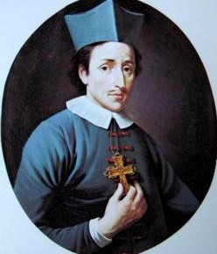
2. Nicholas Steno (1669)
Steno described three fundamental principles used to help relative dating processing.
Superposition
Original horizontality
Lateral continuity
*These three principles are still used and have had others added as information has been gathered.

Slide 7
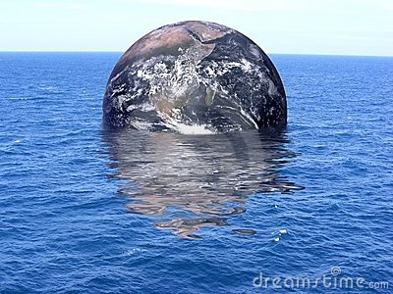
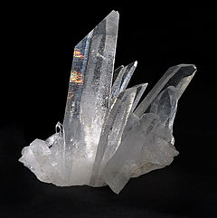
3. Neptunists – 18th Century
This theory states that the entire globe was originally covered by water.
As the water receded sediments were deposited into layers, and rocks crystallized out from the water.
Proposed an Ancient Earth

Slide 8
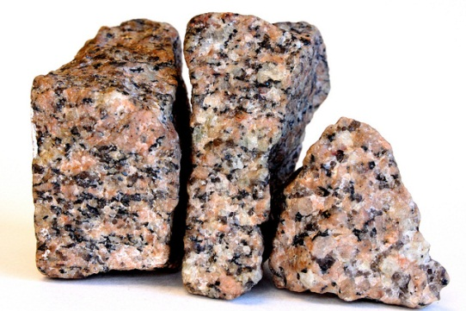
4. Plutonists
As an offshoot of the Neptunists, the Plutonists believed that the rocks crystallized from molten magma as it cooled, not from the evaporating water.
Both groups unsure as to where the water went from the covered Earth.
Continued thought of Ancient Earth.

Slide 9
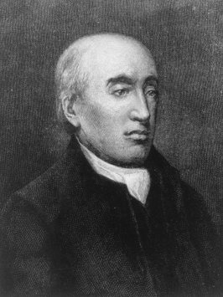
5. Gradualism – James Hutton (1795)
This Scottish geologist is often considered the “Father of modern geology.”
A Plutonist, he stated that the surface of the Ancient Earth is continuously and gradually changing.
Most of this change takes too
long for us to witness during our
own lifetime, but we see the
accumulated effects of millions
of years of change.

Slide 10

6. Faunal Succession – William Smith (1817)
He studied rocks in England.
Used similarities in key fossils to identify similar rock layers.
Use rock “fingerprinting” by finding distinct fossils in rock layers which are not found in the layers below or above.
This principle is used to determine relative age.

Slide 11
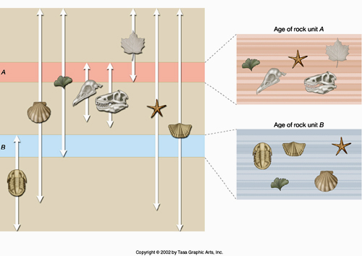

Slide 12
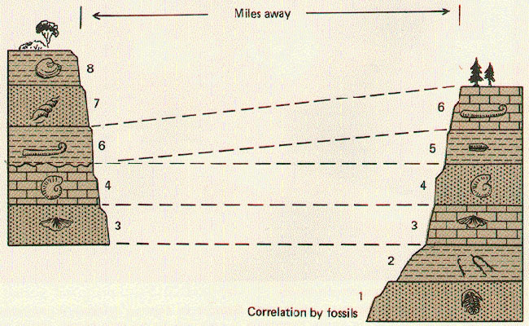

Slide 13
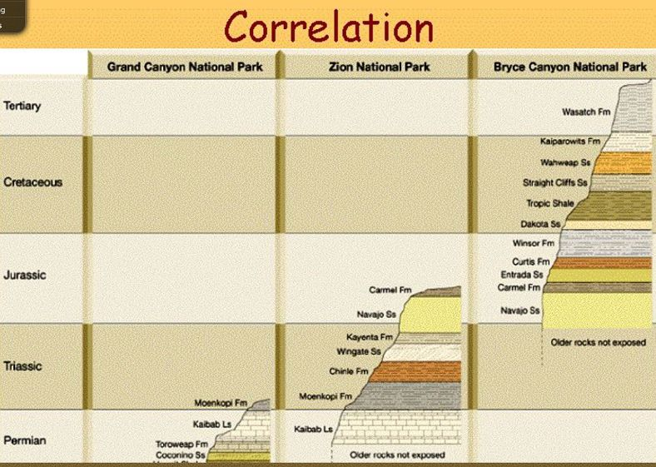

Slide 14
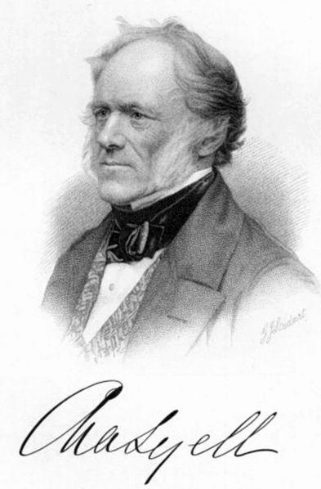
8. Uniformitarianism – Charles Lyell (1830)
Proposed that geologic
processes have always
acted with the same
rate and intensity and
in the same fashion as
they do today.

Slide 15
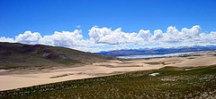
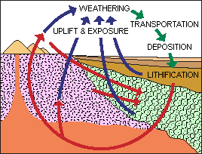
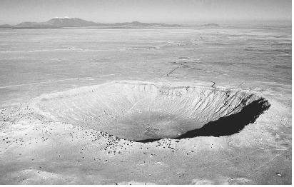
The Laws of Nature have been relatively constant through the entire history of the Earth.
Does not eliminate catastrophic events as quick changes, just that they have always happened in the same manner.
“The present is the key to the past.”

Slide 16
Geologic Time Scale
Geologists widely accept the theory that the Earth is about 4.5 billion years old
This time is divided up into Eons, Eras, Periods, and Epochs
See page 672 in your Glencoe book.

Slide 17
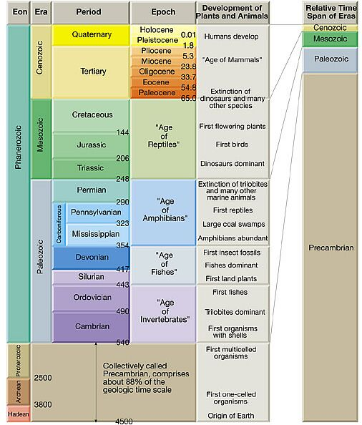

Slide 18
Time Intervals
Eons are the largest division (billions of years)
There are four recognized eons based on evolutionary changes in fossilized life and rocks.
Hadean, Archean, Proterozoic – these three are
collectively called the Precambrian which dates back to
the beginning of the Earth (>85% of the time)
Phanerozoic eon – means “visible life” and contains
the abundance of the fossil record.

Slide 20
Time Intervals
Eras represent 100’s of millions of years
There are three main Eras
1. Paleozoic – “ancient life”
2. Mesozoic – “middle life”
3. Cenozoic – “recent life”
Mass extinctions mark the end of one Era and the beginning of the next, with distinct fossils in each era.

Slide 22
Time Intervals
Periods represent millions of years, and are named after an area in the world where rocks of that age were first located.
Examples include:
→ Devonian, Triassic, Carboniferous, and
Quaternary periods
There are many distinct layers of rock thought to have formed during a specific period

Slide 24
Time Intervals
Epochs are the shortest time division and are usually used to represent the last 66 million years or so of the Earth.
The Paleocene epoch begins with the mass extinction event of the dinosaurs.
We are currently in the Holocene epoch which began with the end of the most recent ice age.

Slide 26




Dating
Scientists are always trying to figure out how old things are and what came first.

Slide 27





Relative Age vs. Absolute Age
Relative age – a geologic order of events
→ What came first? What layer is oldest?
→ What is the sequence of oldest to youngest?
→ Geologists use multiple rock layers to
determine sequence.

Slide 28
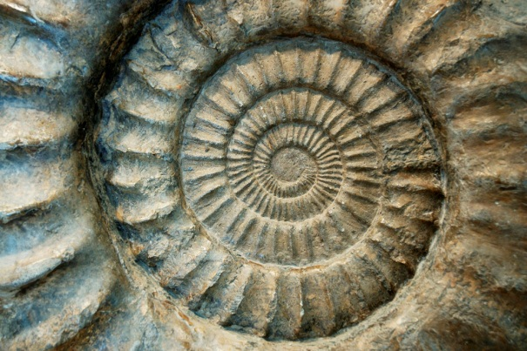
Relative Age vs. Absolute Age
The problem is that some layers may be missing in some samples. Multiple samples must be used to fill in the blanks.
Use distinctive fossils or rock layers, and deposits from multiple samples to determine the relative age of rocks and rock layers.

Slide 29
Relative Age vs. Absolute Age
Absolute age – the actual age of a rock or a layers of rock
Uses radiometric date as a primary testing method
Measures radioactive materials with an
experimentally tested and consistent half-life
during the time tested.
*There are concerns that this method is unreliable.

Slide 30
Radiometric Dating
Unstable (radioactive) materials will spontaneously break down into more stable nuclei and emit particles and energy
This breakdown occurs with a specific measureable rate which scientists measure
Called the half-life, due to the time it takes for ½ of a sample to decay into another sample.

Slide 31
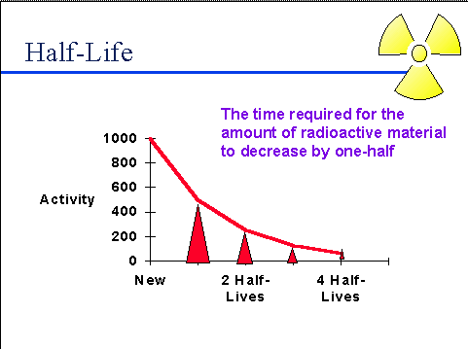

Slide 32

Radiometric Dating
Scientists use the current percentages of radioactive materials found in nature and objects and the half-life to calculate in reverse how much time has gone by, back to when that material was formed

Slide 33
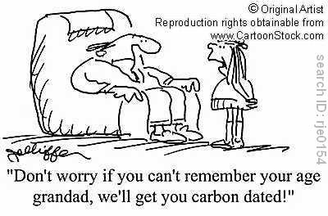
Radiometric Dating
The most commonly used are:
Carbon-14
Potassium-Argon dating
Uranium-Lead dating

Slide 34


Radiometric Dating
The accuracy of these methods has been called into question.
Several assumptions must be made for the dating techniques to be accurate.
All conditions in nature have been consistent with those we see today.
No contamination of the sample has occurred at any point in time
The decay rates been constant through billions of years of time.
We cannot answer these three assumptions one way or the other.

